Slide 1
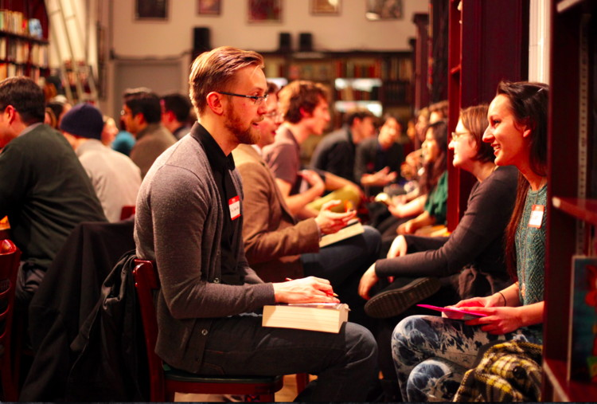
Speed dating dataset
Stat 517 – final project – vignesh j muralidharan

Slide 2
overview
Introduction
Data description
Classification models
Performance of models
Clustering analysis
Association analysis
Results
conclusion

Slide 3
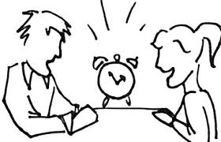
introduction
Data gathered from participants in experimental speed dating events of 2002-2004
Attendees would have to talk with opposite sex and were asked if they would like to see their date again
A questionnaire of data gathered from participants
similar questions were asked with each partner so that to get an idea of population
Aim: develop approaches for predicting whether a partner on the dating event is (“match” – “1”) or not (“not-match” – “0”) so that people can think on decisions

Slide 4
Data description
Gender
Age
Race
Field of study
Rate based on
Attractiveness
Sincerity
Intelligence
Funny
Ambition
Shared interest
sports
Dining
Museums
Art
Hiking
Gaming
Clubbing
Reading
Tv
Theater
Movies
Concerts
Music
Shopping
yoga
DIMENTION OF THE DATA ⬄ 8378 ® & 123 ©
It’s a two way questionnaire – which means every time a person meet opposite sex, same questions were asked to other person too
Survey also includes,
Preference of yours on the rate based questions
How do you rate the partner
How does partner gives importance on the rate based questions
How do you rate yourself on the rate based questions
Did you like the partner?
How likely do you think partner likes you?
Decision at the event ?
MATCH ? ⬄ TARGET VARIABLE – BINARY (1- MATCH, 0 – NOT MATCH)

Slide 5
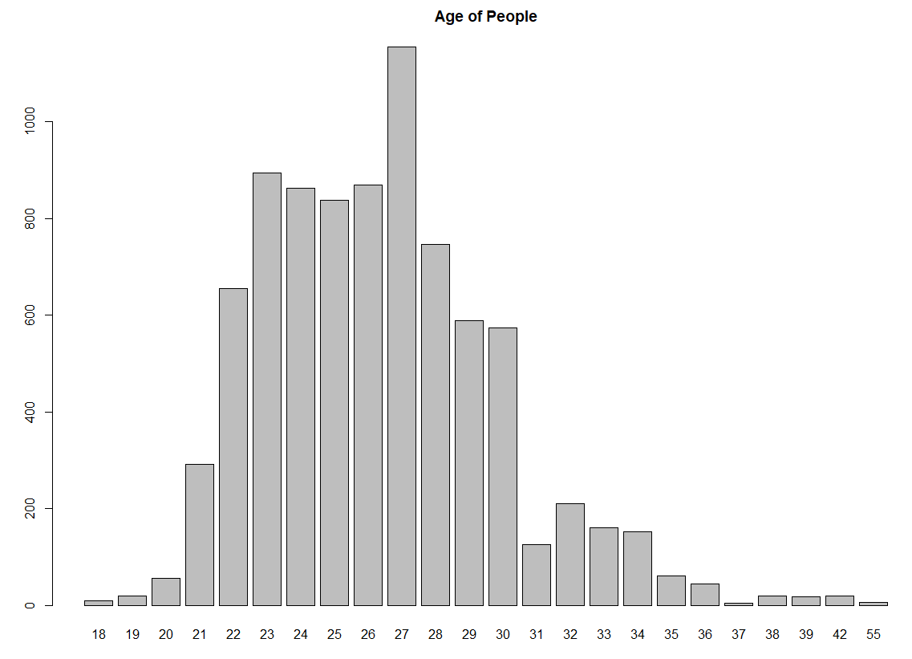
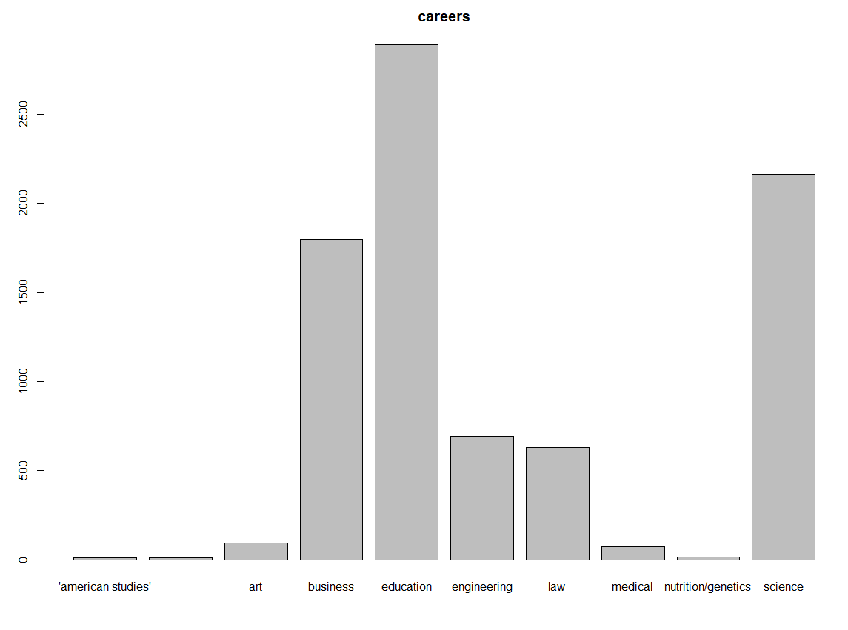
Data description

Slide 6
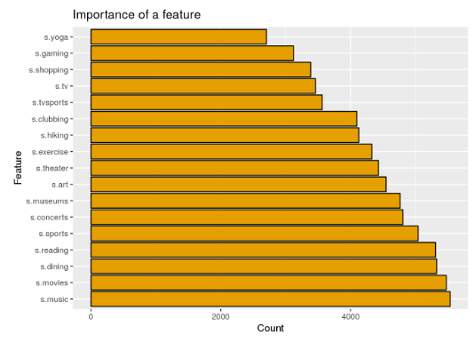
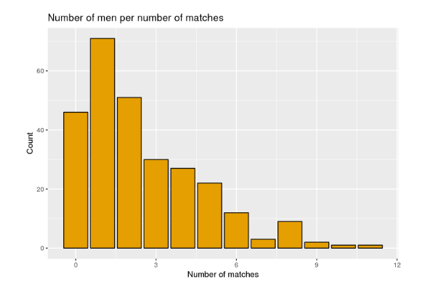
Data description

Slide 7
preprocessing
STARTING WITH “?” IT HAS BEEN REVALUED TO “Na”
“Na” IMPUTATION PROCESS TO REPLACE THE HIGHEST NUMBER OF REPEATED LEVELS
VARIABLE “FIELD OF STUDY” – CHANGED 262 LEVELS TO 10 major levels
Classification – removed string variables – dim ⬄8378 ® & 117 ©
Clustering
Cluster 1 (personal survey) – removed string variables + target = dim ⬄ 8378 ® & 62 ©
Cluster 2 (partner survey) – removed string variables + target = dim ⬄ 8378 ® & 62

Slide 8
Classification models
8 classification methods were used to train models and make predictions
Naïve bayes
Logistic regression
K nearest neighbors
Decision tree
Random forest
Gradient boosting classifier
Support vector machine
Neural networks
Evaluation of the models were make to see which models perform better
Performance of models were analyzed with
train-test score – accuracy score
Roc curve

Slide 9
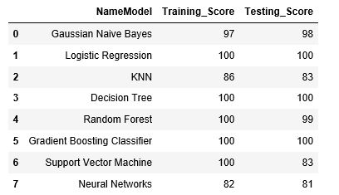
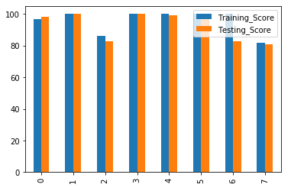
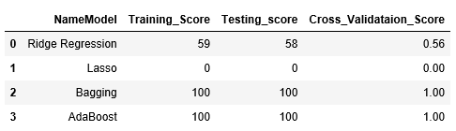
Classification - results
Logistic, Decision Tree and Gradient Boosting Classifier performed better than other models

Slide 10
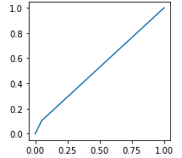
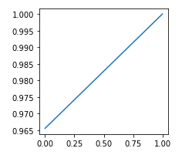
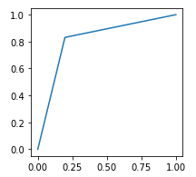
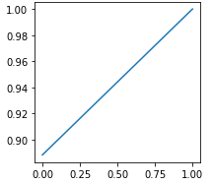
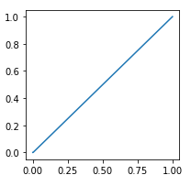
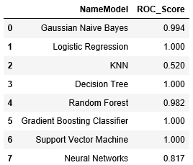
CLASSIFICATION – RESULTS – ROC CURVE
KNN
RF
NN
LOG
NB
SVM
DT

Slide 11
CLUSTER ANALYSIS
Analysis done to see if it really shows the same “Match” between the partners
Data divided into – personal decision & partner decision = which makes “Match”
personal decision = 61 variables
Partner decision = 61 variables
PCA was used to reduce the dimension – 22 pcs was used
Number of clusters k = 2 was used to see the match if it equals the actual dataset
Model name | # of clusters
K-means | WSS – 3 Silhouette – 2 Gap_Stat – 2 <= took 2 hours to run
Mclust | 5 (Best Model – VVE)
NBClust | 4 <= took 5 hours to run

Slide 12
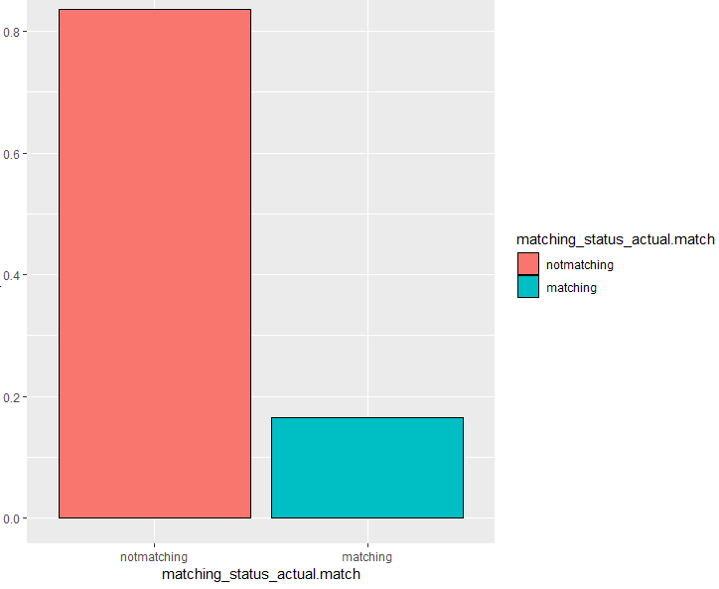
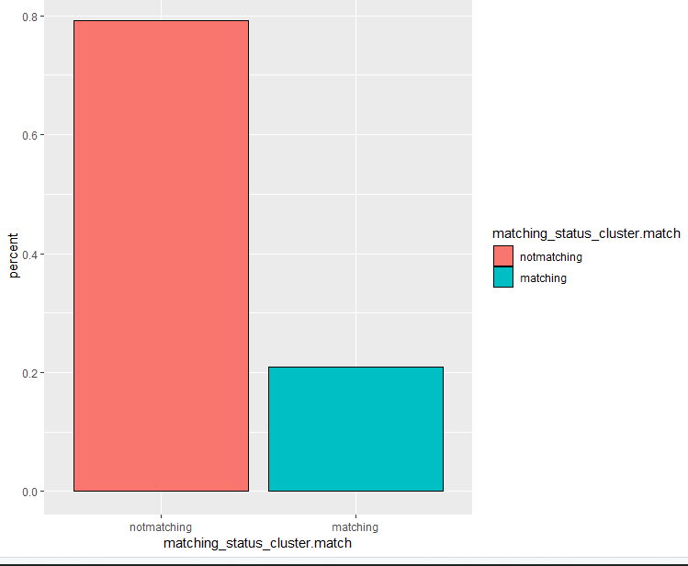
“match” results between actual and after cluster

Slide 13
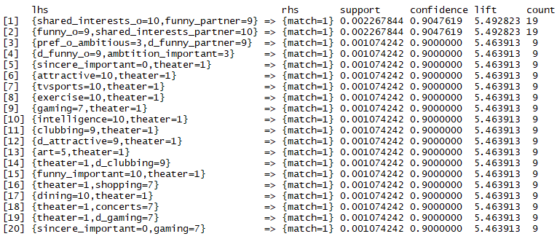
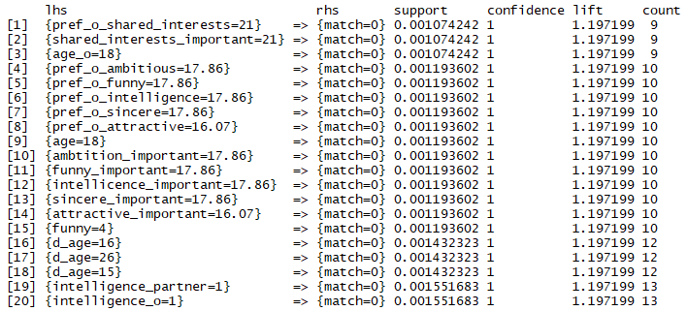
Association rules – ACTUAL DATASET
MATCH - 1
NOT MATCH - 0

Slide 14
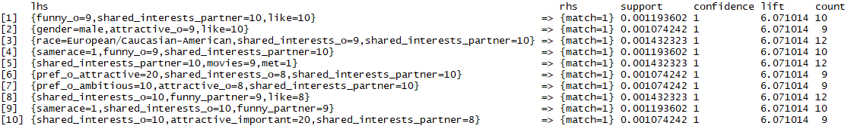
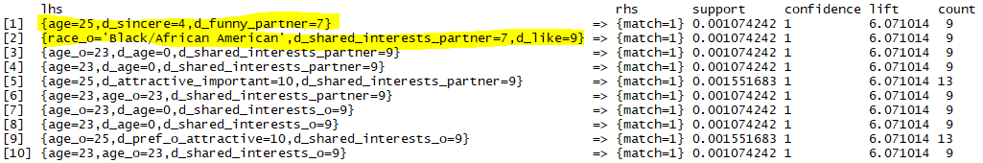
ASSOCIATION RULES – PERSONAL VS PARTNER PREFERENCE
PERSONAL PREFERENCE
PARTNER PREFERENCE

Slide 15
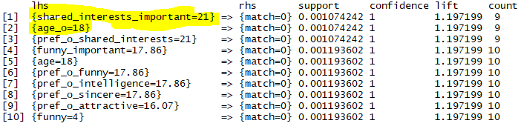
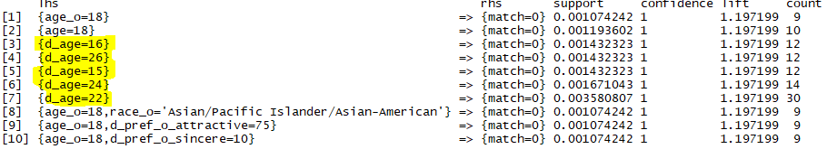
ASSOCIATION RULES – DISLIKES BETWEEN PARTNERS
PERSONAL DISLIKES
PARTNER DISLIKES
Age difference

Slide 16
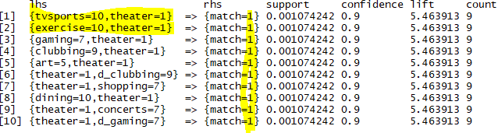
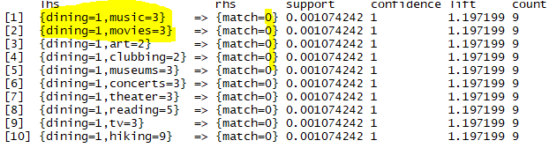
ASSOCIATION RULES – SPECIFIC INTEREST
MATCH – 1
NOT MATCH - 0

Slide 17
CONCLUSION
BOTH ACCURACY AND ROC CURVES SHOWED THAT MOST MODELS PERFORMED PRETTY WELL IN DETECTING THE MATCH, ESPECIALLY LOGISTIC REGRESSION AND DECISION TREE
WAS ABLE TO MATCH MOST OF THE PEOPLES DECISIONS THROUGH CLUSTERING METHODS
BEING FUNNY, SINCERE, AGE OF ^ 25 & HAVING SHARED INTERESTS MATCH MOST OF THE PEOPLE AT THE EVENT
BEING AGE -18 & DIFFERENCE IN AGE ^ 16 WITH SPECIFIC RACE WAS DISLIKED BY MOST OF THE PEOPLE
BEING SPECIFIC INTEREST OF TVSPORTS, THEATER & EXERCISE GOT THE MATCH PRETTY EASY RATHER THAN LIKING MUSIC, MOVIES & DINING

Slide 18
FUTURE WORK
WILL DEVELOP CLUSTER ANALYSIS MORE TO UNDERSTAND THE GROUP BETTER AND SEE HOW RATE BASED VARIABLES GROUPS ACCORDING TO THE ACTUAL MATCH
WILL DEVELOP MORE SUITABLE ASSOCIATION RULES

Slide 19
THANK YOU

